Slide 1
MARCH
SHOW AND TELL

Slide 2
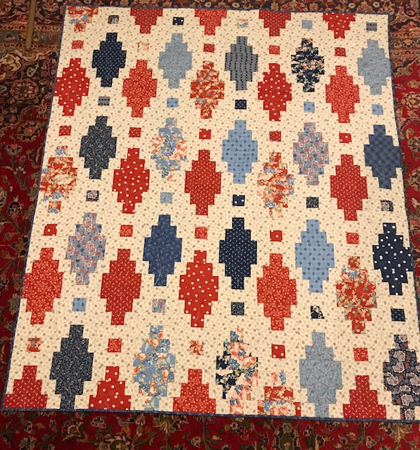
JULIE SANDER
JULIE MADE THIS QUILT FOR THE WOMEN’S VETERANS PROJECT. SHE USED THE BEADED LANTERN PATTERN FROM OUR COVID QUARANTINED QUILTERS DAY OUT.

Slide 3
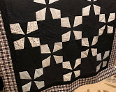
KATHLEEN HIGBEE
THE FIRST FOUR QUILTS BY KATHLEEN WERE MADE FROM SOME OF HER FATHER’S CLOTHING AFTER HE PASSED AWAY FROM PROSTATE CANCER IN MARCH OF 2020.
THE LIGHT FABRIC IN EACH OF THESE BLOCKS WAS MADE FROM HIS PJS OR BOXERS.

Slide 4
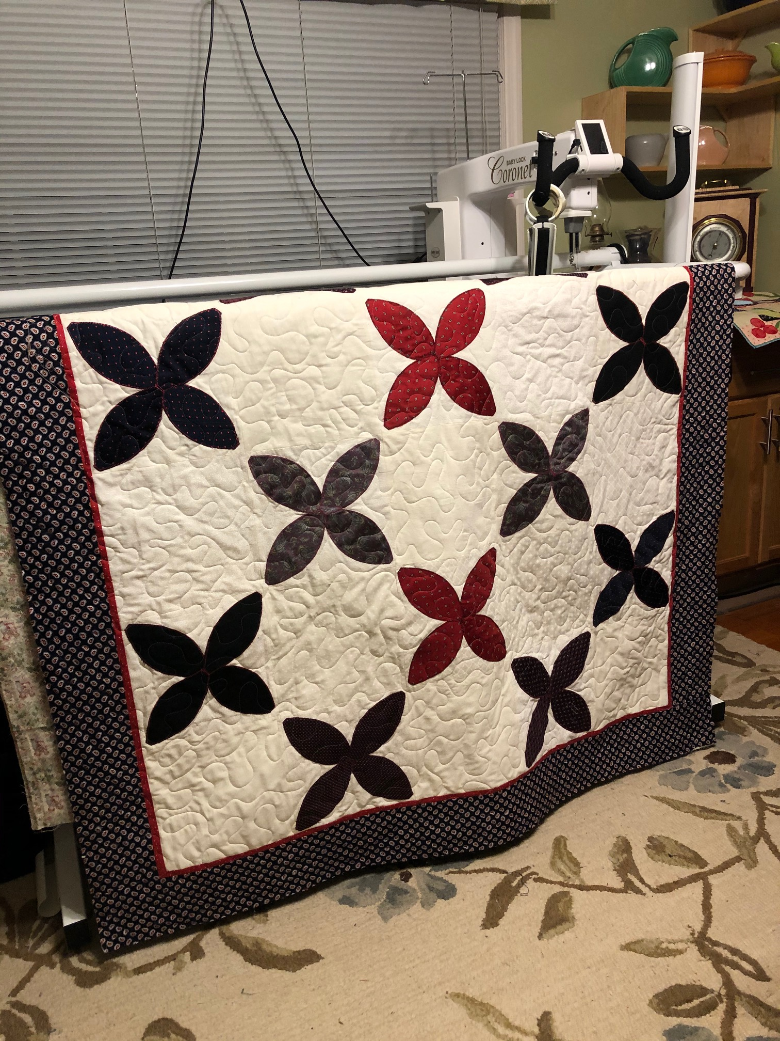
THE ORANGE PEELS IN THIS QUILT WERE MADE FROM KATHLEEN’S FATHER’S TIES.

Slide 5
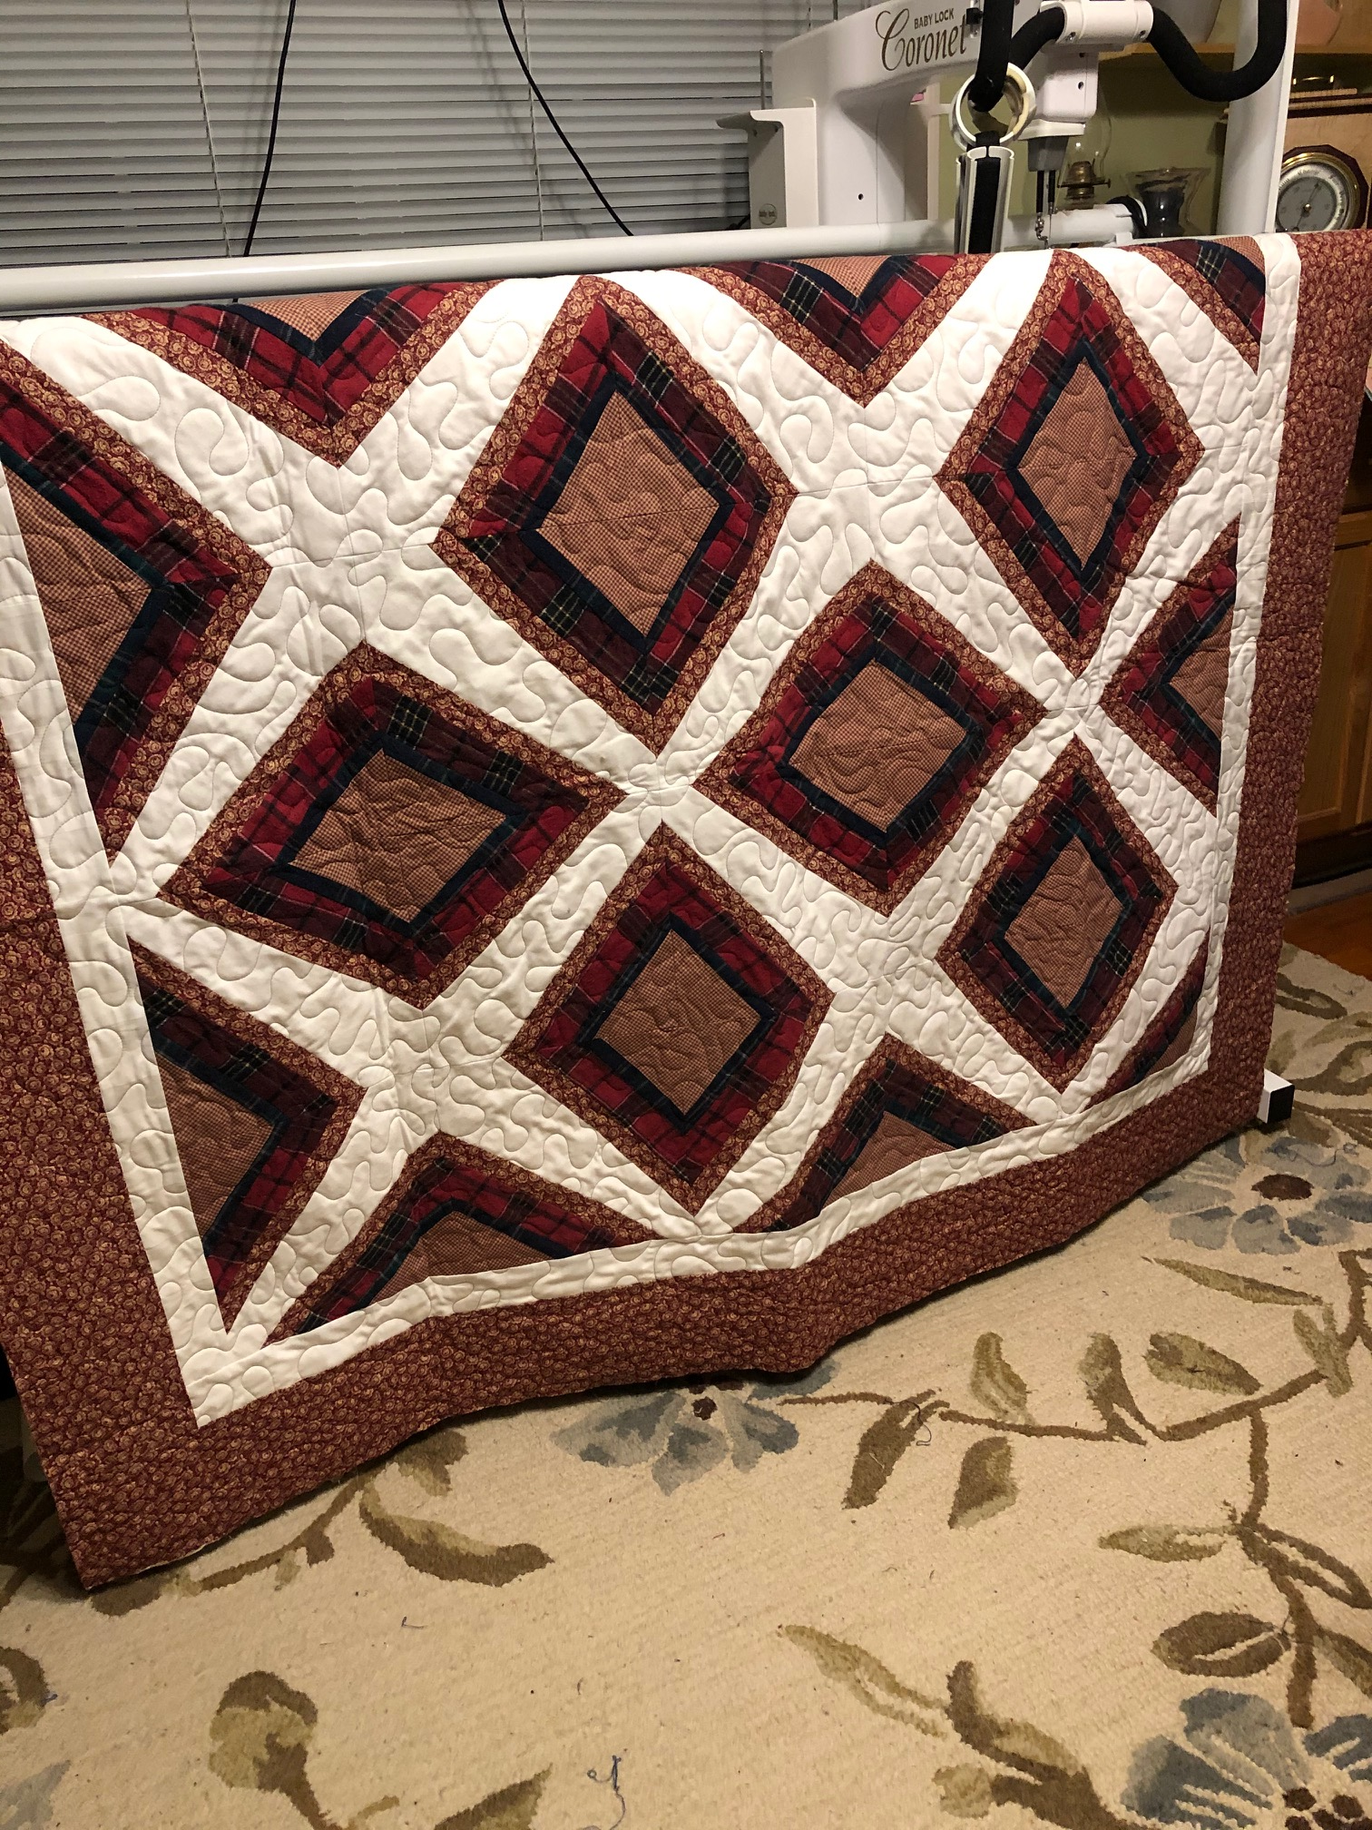
THE WHITE FABRIC THAT FORMS THE Xs WERE MADE FROM A WHITE SHIRT OF KATHLEEN’S FATHER. THE BURGUNDY FLANNEL STRIPS WERE FROM HIS SHIRTS.

Slide 6
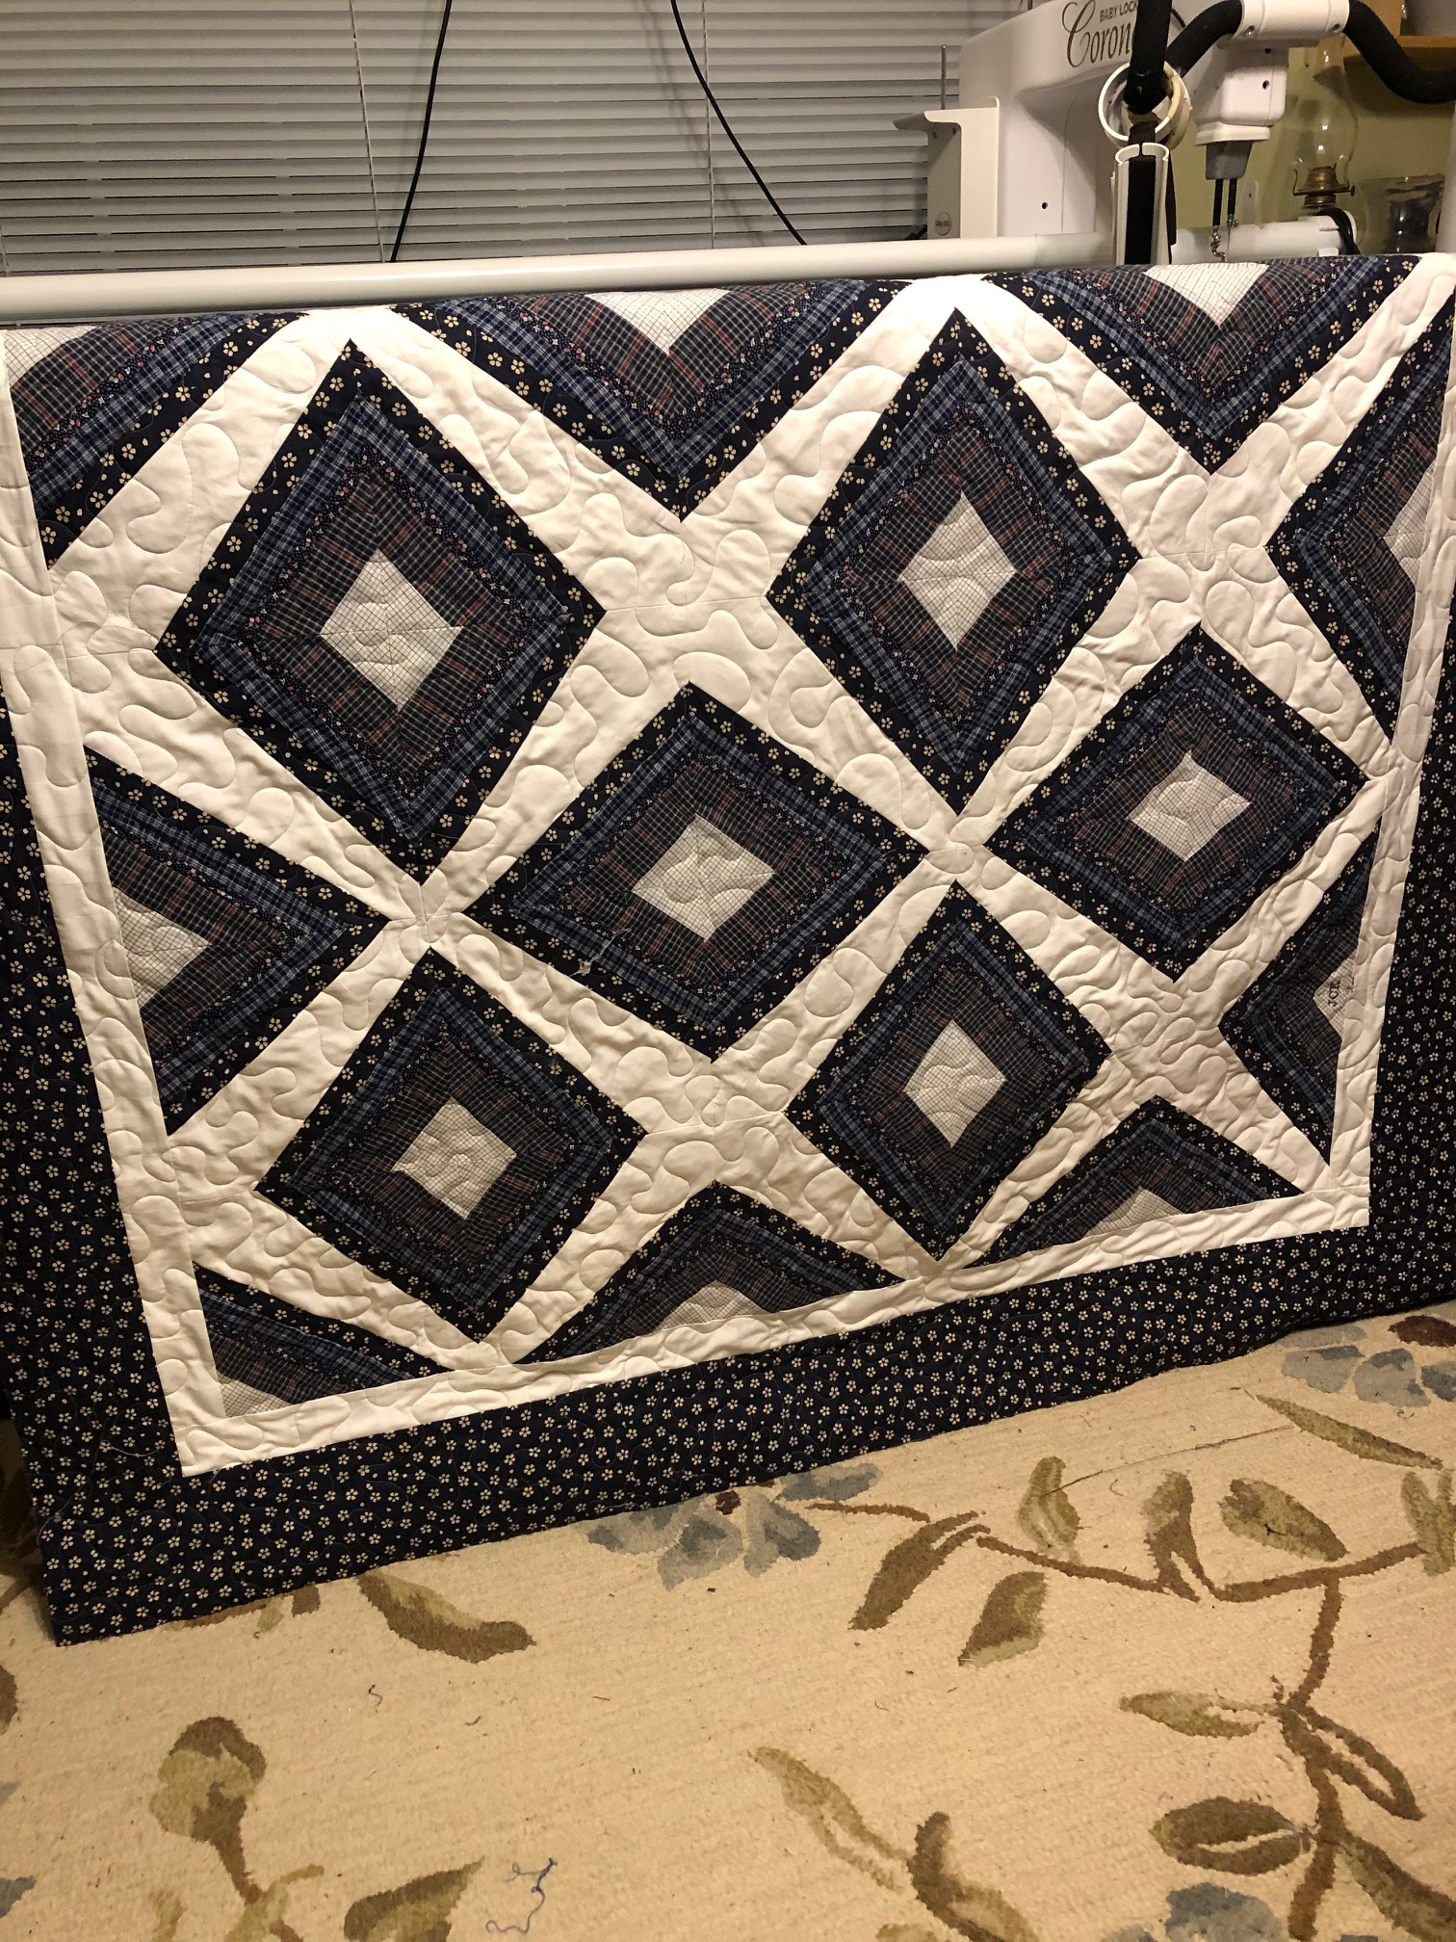
HERE KATHLEEN USED ANOTHER OF HER FATHER’S WHITE SHIRTS. THE CENTER OF EACH BLOCK IS FROM HIS PJS. THE REMAINDER OF THE BLOCK IS FLANNEL FROM EITHER HIS SHIRTS OR LOUNGE PANTS.

Slide 7
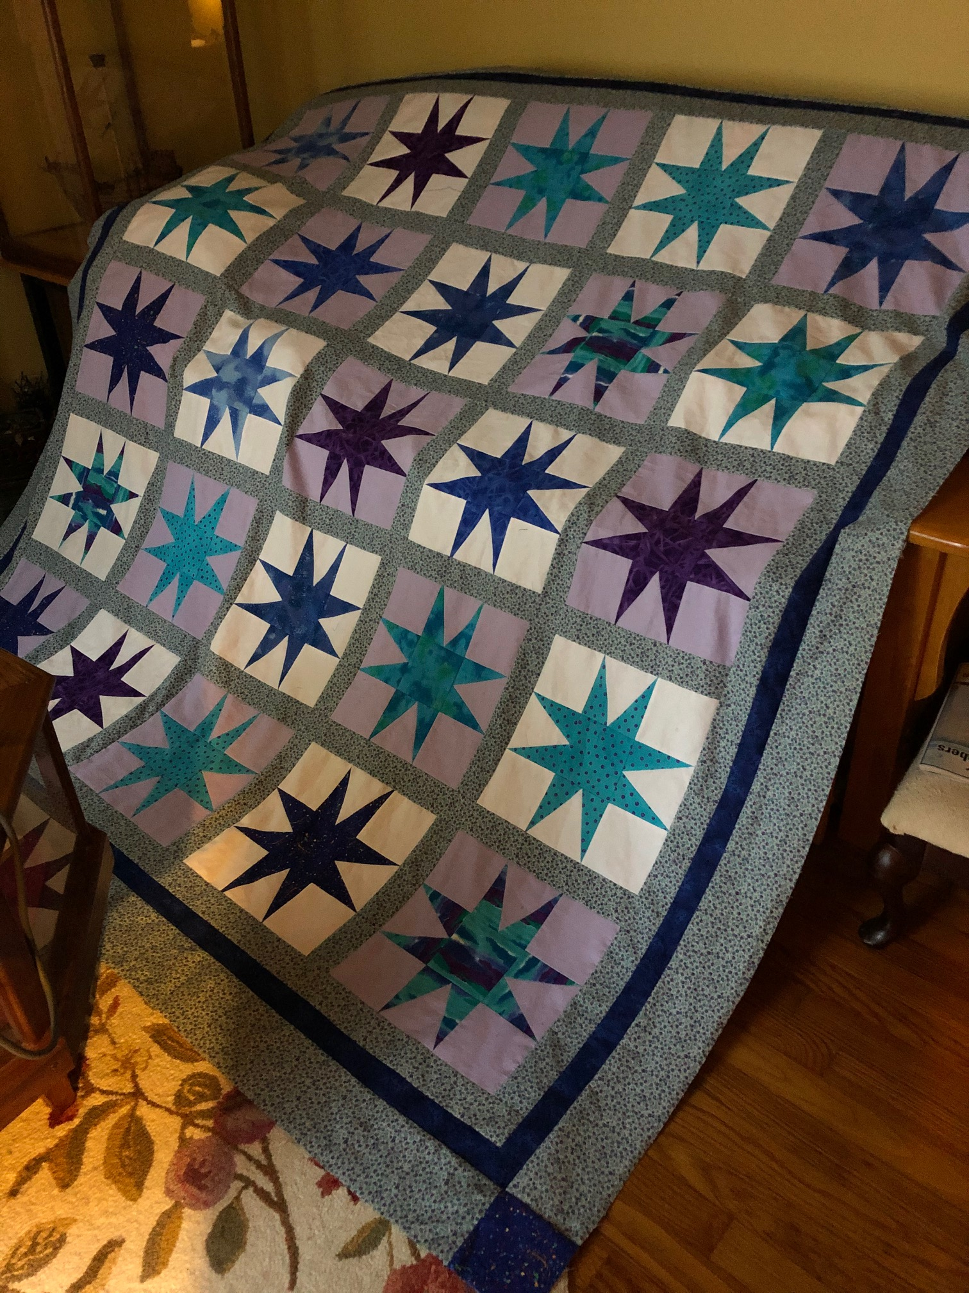
KATHLEEN HIGBEE
IN ADDITION TO MAKING THE FOUR QUILTS FOR HER DAUGHTERS FROM HER FATHER’S CLOTHING, KATHLEEN MADE FIVE OTHER QUILTS IN 2020!
SHE MADE THIS FLANNEL QUILT COMPLETELY FROM HER STASH. QUEEN SIZE!!

Slide 8
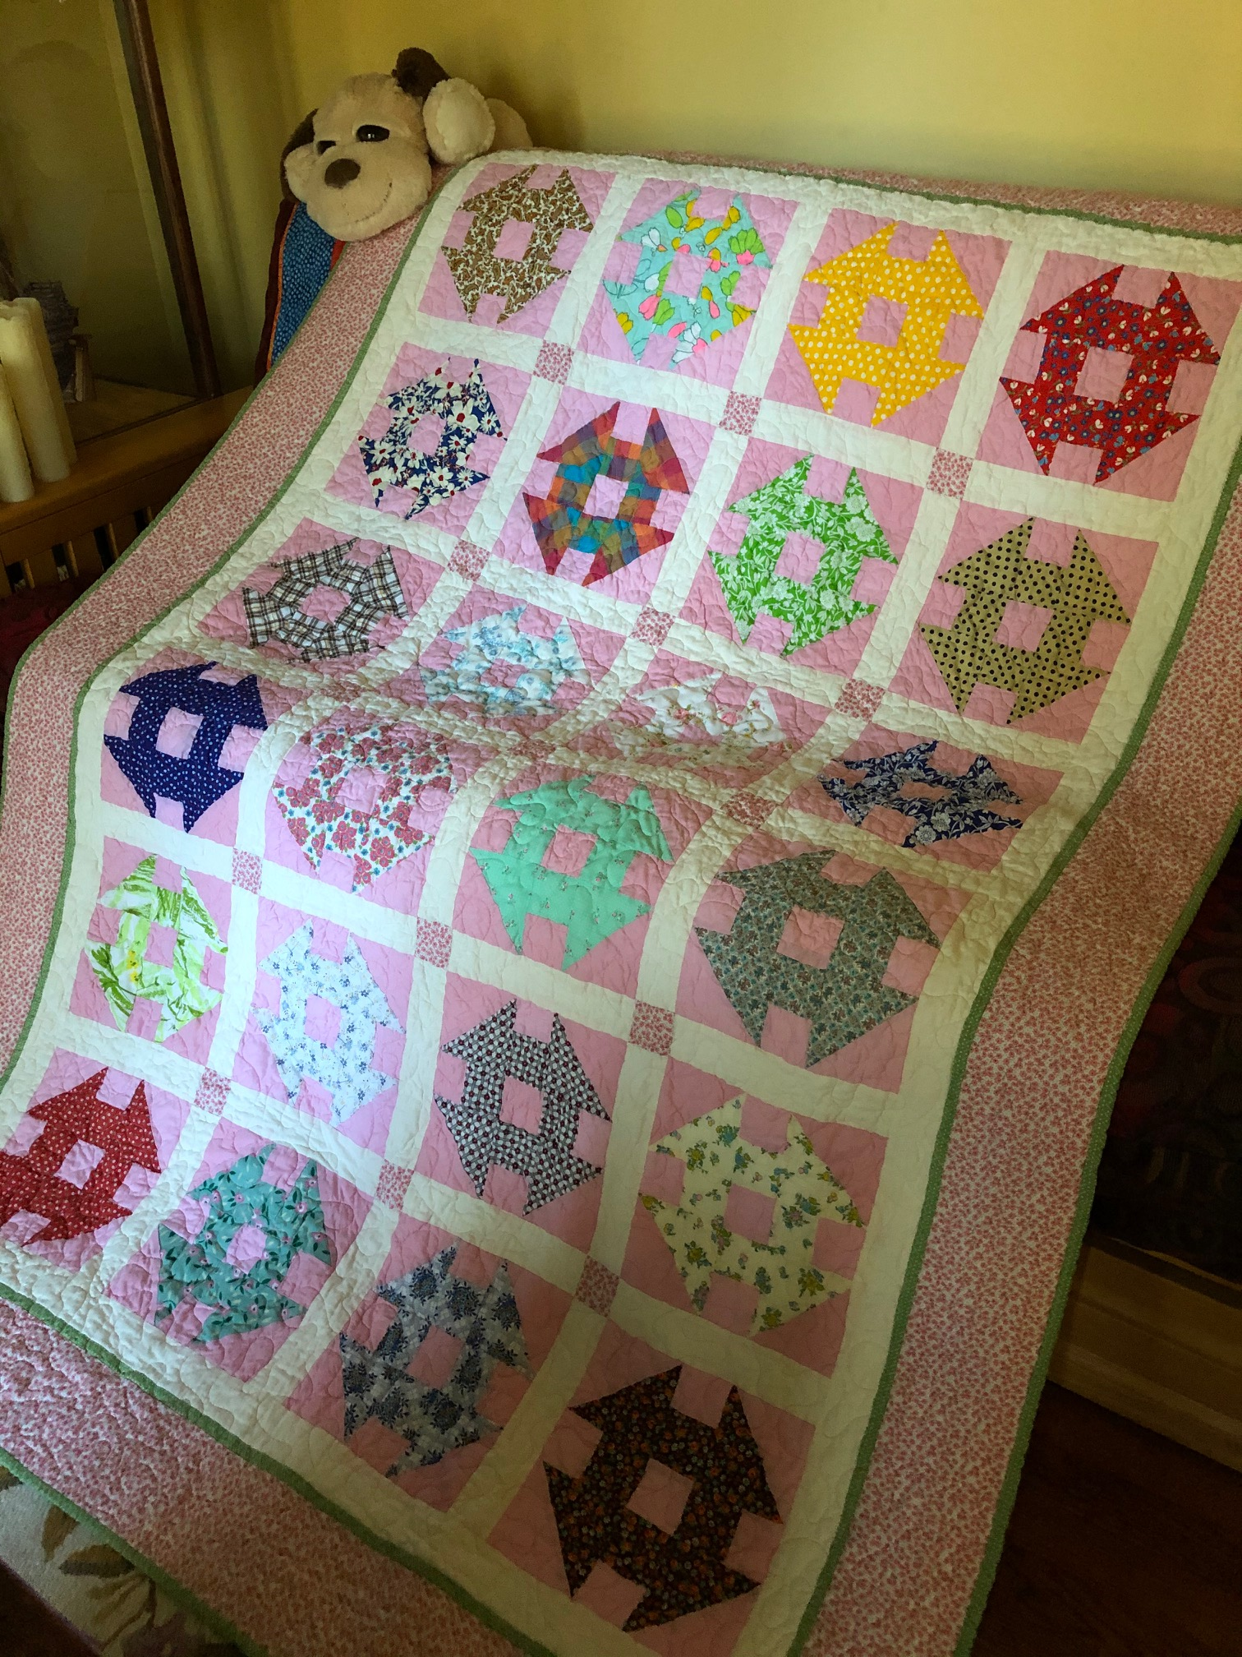
KATHLEEN FOUND THESE HAND PIECED BLOCKS IN A THRIFT STORE IN ORANGEBURG. SHE PUT THEM TOGETHER AND GIFTED THE QUILT TO ONE OF OUR NEWEST GUILD MEMBERS….CATHY CRAMER FROM GOOD CREEK.
NEEDLESS TO SAY, CATHY WAS DELIGHTED!
I LOVE CHURN DAS SO IF KATHLEEN EVER FINDS MORE BLOCKS I HOPE SHE CALLS ME.

Slide 9
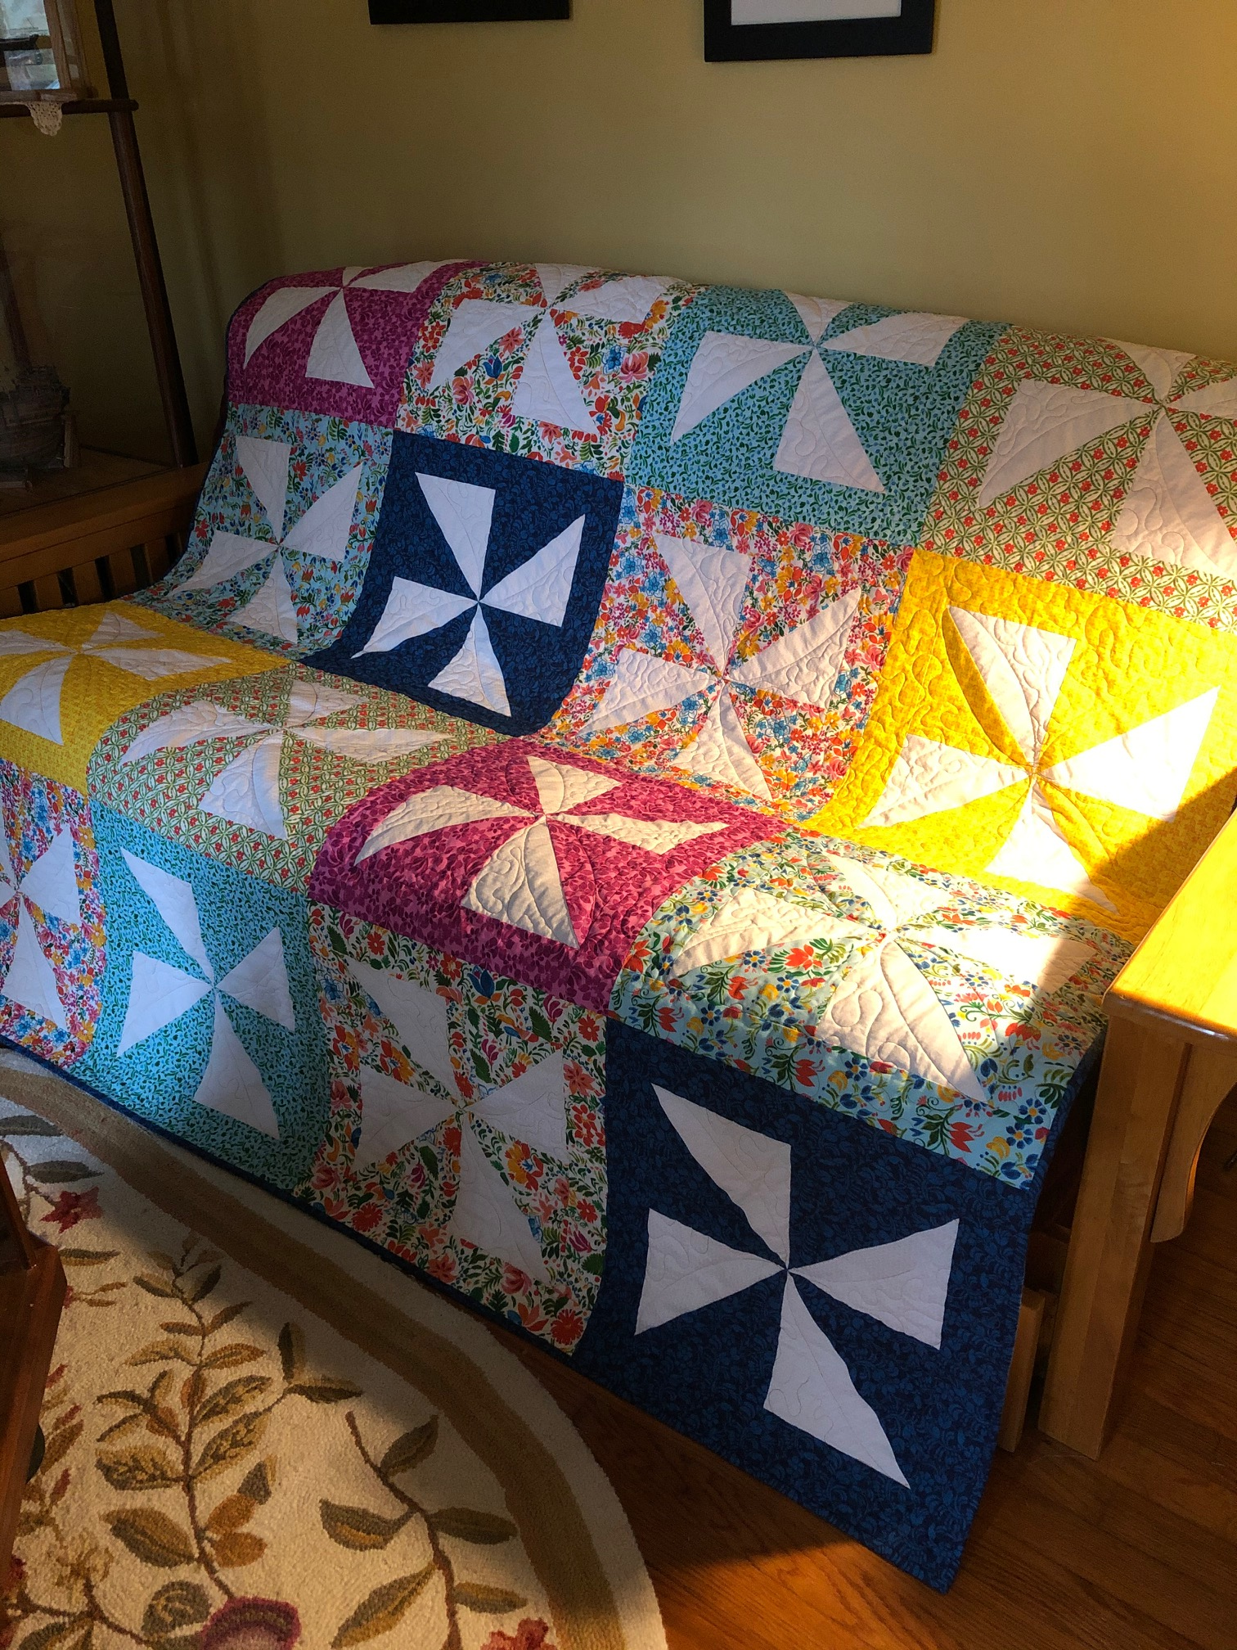
KATHLEEN HAS BEEN TRAVELING BACK AND FORTH TO MASSACHUSETTS TO TAKE CARE OF HER PARENTS FOR A FEW YEARS NOW. SHE GAVE THIS QUILT TO HER NEIGHBOR WHO WATCHES HER HOME HERE AS A THANK YOU GIFT. IT WAS A KIT FROM JOANN FABRICS.

Slide 10
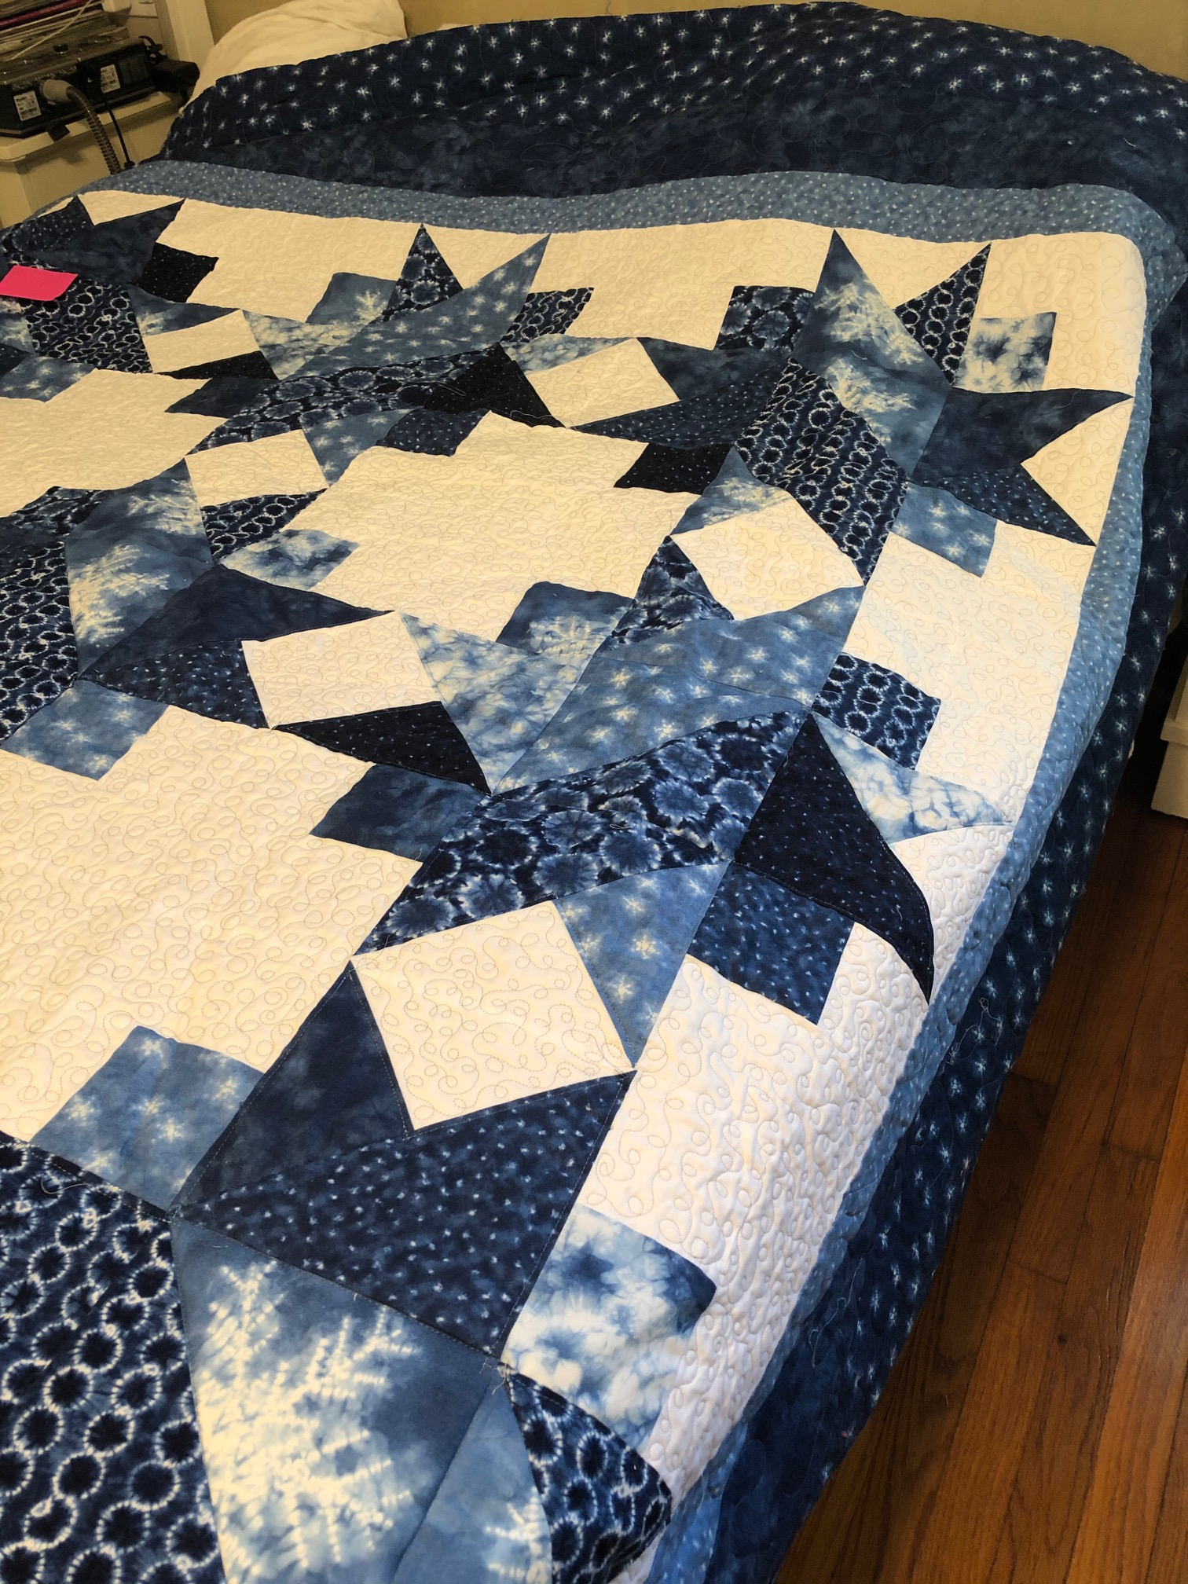
KATHLEEN MADE THIS QUILT FOR HER NEPHEW AND HIS WIFE. IT’S KING SIZE AND SHE QUILTED IT ON HER BABY LOCK CORONET.

Slide 11
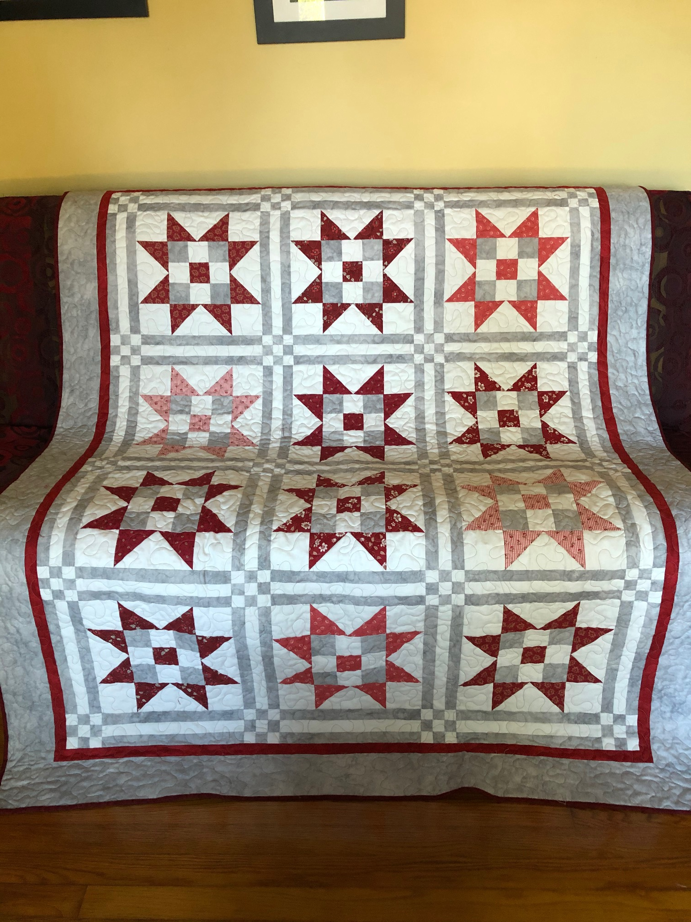
KATHLEEN MADE THIS ONE FOR THE SON OF A FRIEND FROM GREENWOOD. SHE AND HER FRIEND HAD BEEN WORKING ON QUILTS FOR EACH OF THE FRIEND’S CHILDREN. THE FRIEND PASSED AWAY SUDDENLY AND KATHLEEN WANTED TO BE SURE THE OTHER CHILDREN RECEIVED A QUILT.

